Slide 1
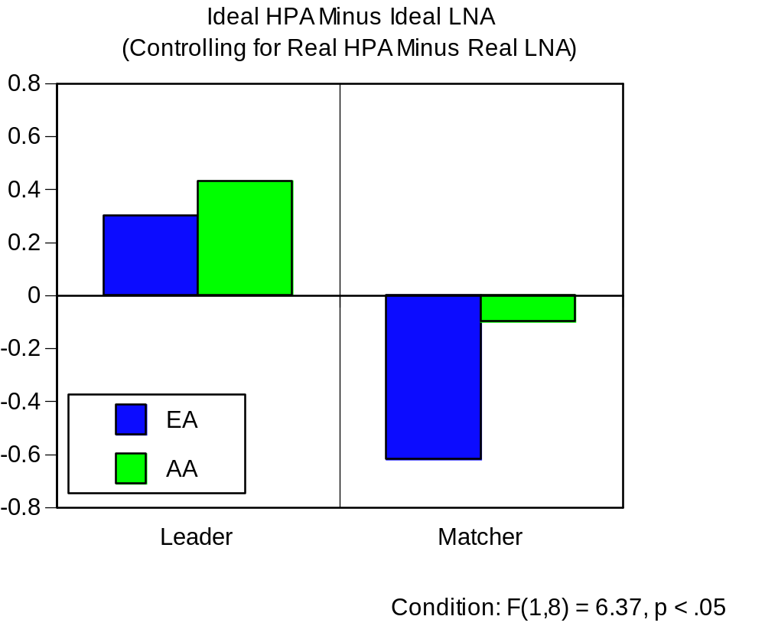

Slide 2
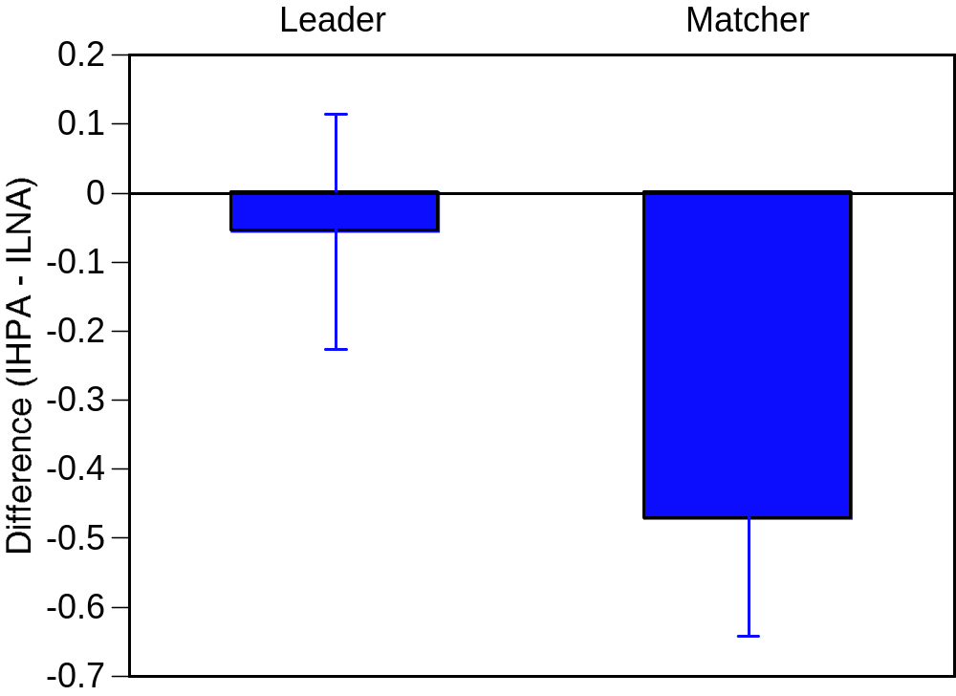
Across Groups, Matcher Values LNA (Relative To HPA)
More Than Leader

Slide 3
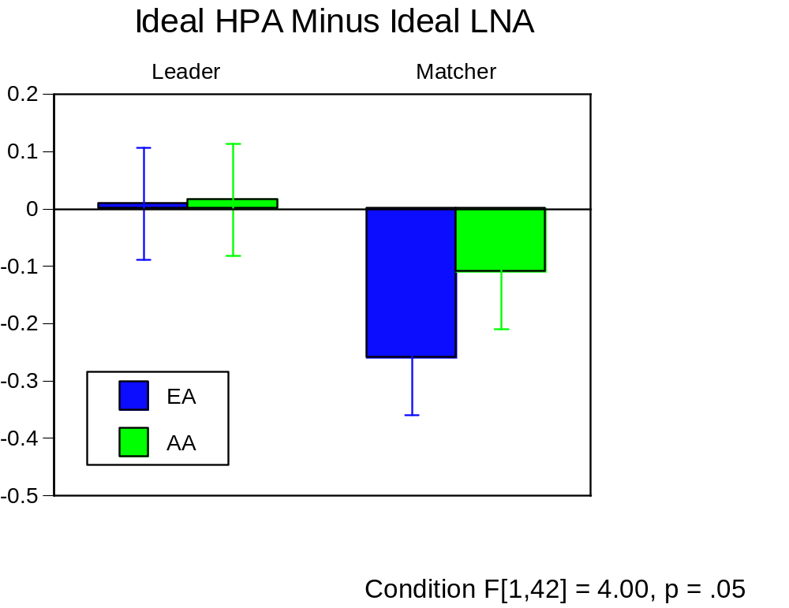

Slide 4
